Slide 1





Jira-AzureDevops
&
Jira-GitLab
October 2022
55 Shuman Blvd, Suite 275, Naperville, IL 60563 Tel: +1.630.355.6292 | Email: info@royalcyber.com

Slide 2



Agenda
1
Jira-AzureDevops Integration
2
Jira-GitLab Integration
3
Power Automate Flow for AzureDevops
4
Power Automate Flow for GitLab
5
Alternate Options
6
Conclusion

Slide 3
Jira-AzureDevops Integration
Use Prebuilt Marketplace tools to sync the data
Use the Native integration tool that is part of releases in AzureDevops to notify Jira Issues
Create a Power Automate Flow to create bidirectional sync

Slide 4
Jira-GitLab Integration
Basic Gitlab- Jira Integration
Migrate from Jira to Gitlab
Jira Dev Panel Integration
Power Automate
ThirdParty Apps

Slide 5
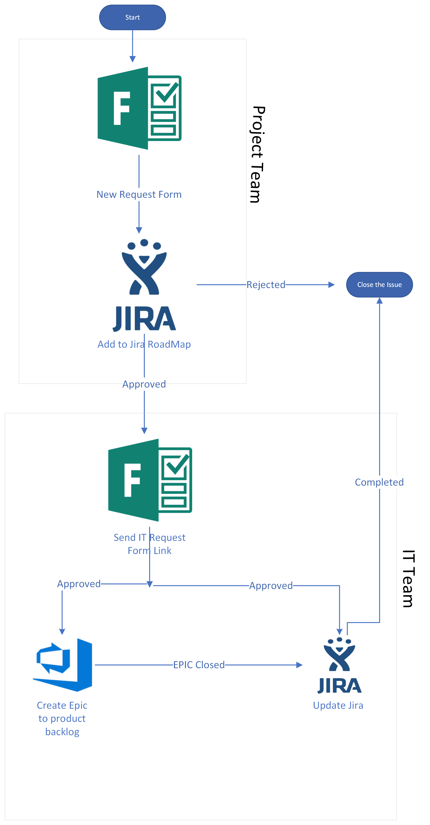
Power Automate Flow for AzureDevops
Power Automate
Microsoft Forms
Jira Connector
Azure Devops Connector
Email/Team Connector

Slide 6
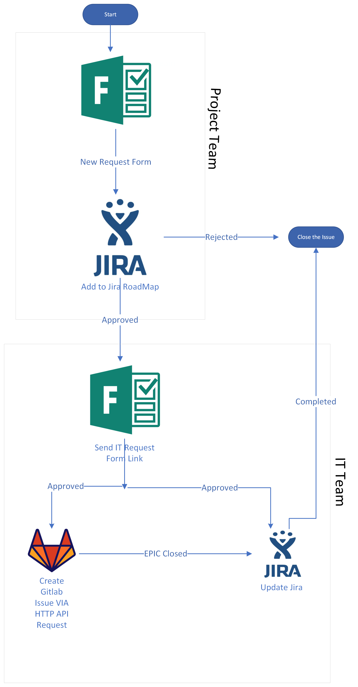
Power Automate Flow for GitLab
Power Automate
Microsoft Forms
Jira Connector
HTTP Connector
Email/Team Connector

Slide 7
Alternate options
Zapier
ThirdParty tools
Custom Code Implementation

Slide 8
AzureDevops Vs GitLab
AzureDevops | GitLab
Ideal Solution for Microsoft Shop | Not Ideal for Microsoft shop
No Native Security Solutions | In Built Security Solutions
Supports Native .net and other PL Tests | Doesn’t have the .net and other PL tests
Lack of Yaml support in release pipelines | Yaml is supported at all phases
Native Support to deploy to any cloud | Lack of native support for publication to AWS, Google and Azure clouds,
Dashboard Availability | Lack of Dashboards
User Support is Exceptional | User Support is Good
Not many Advance features available | Lot of Advance Features available
https://about.gitlab.com/devops-tools/azure-devops-vs-gitlab/

